Slide 1


Training Volunteers
The ARRL
Introduction to Emergency Communication Course
EC-001 (2011)
Session Five
Notes:
Make sure you have modified the Name and Date.
Display this screen as students are arriving for class.

Slide 2
Reminder
Complete two DHS/FEMA Courses
IS-100.b Introduction to ICS
IS-700 National Incident Management System
Http://training.fema.gov/IS/NIMS.asp
Notes:
ARRL conditions!
The two ICS courses must be complete before taking the final exam.

Slide 3
Session Five Topic
Session 1 – Topics 1, 2, 3, 4, 5a, 5b
Session 2 – Topics 6, 7a, 7b, 7c, 7d, 8, 9, 10
Session 3 – Topics 11, 12, 13, 14, 15
Session 4 – Topics 16, 17, 18, 19, 20
Session 5 – Topics 21, 22, 23, 24, 25, 26, 27
Session 6 – Topics 28, 29, Summary, Final Exam
Notes:
The course requires a total of 18 hours.
If a student misses one class they can take a practice quiz for each lesson missed.
A student missing two sessions will be asked to take the course again.
A student missing the last session must wait for the next class and attend the final session for taking the exam again.
An exception would be two Field Examiners agreeing to give the exam at a mutually scheduled time.

Slide 4
Topic 26 – Hazardous Materials Awareness

Slide 5
Hazardous Materials
Amateur radio operators may encounter HazMat incidents, or to assist with emergency communications in such incidents
HazMat
Any substances or materials, which if released in an uncontrolled manner (e.g., spilled), can be harmful to people, animals, crops, water systems, or other elements of the environment

Slide 6
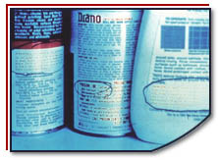
Hazardous Materials . . .
Corrode other materials
Explode or are easily ignited
React strongly with water
Are unstable when exposed to heat or shock
Are toxic to humans, animals, or the environment

Slide 7


HazMat
Explosives
Gases
Flammable and combustible liquids
Flammable solids or substances
Poisonous and infectious substances
Radioactive materials
Corrosives

Slide 8




Sources of Hazardous Materials
Chemical plants
Service stations
Hospitals
Hazardous materials waste sites
Transport vehicles

Slide 9

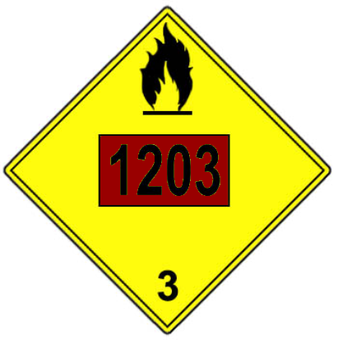
Hazardous Chemicals On The Move Regulatory is the Department of Transportation (DOT)
Symbol
Symbol
Chemical
Number
Name
Chemical Class
Chemical Class
Gasoline Tanker
Notes:
You may recognize some of the more common ones, such as 1993, which covers a multitude of chemicals including road tar, cosmetics, diesel fuel, and home heating oil. You may have also seen placards with the number 1203 (gasoline) on tankers filling the underground tanks at the local gas station.

Slide 10











Identifying Hazardous Materials in Transit
Red &
Orange
Red
White
Red
White
Red &
Blue
Yellow
White
Yellow &
Black &
White
White
White

Slide 11
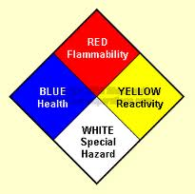
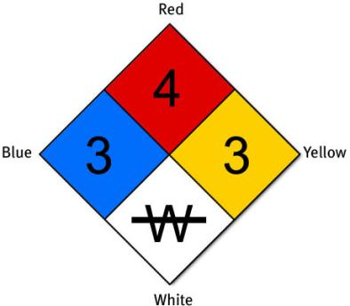
Hazardous Chemicals in Buildings
NFPA 704M

Slide 12
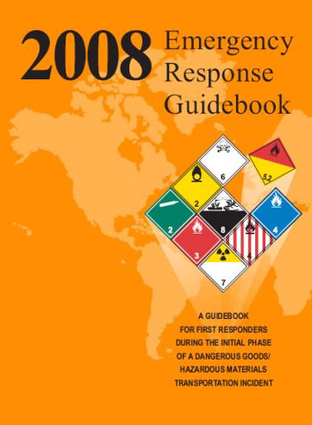
Reporting a HazMat Incident
http://phmsa.dot.gov/hazmat/library/erg

Slide 13
Guidelines for Handling HazMat Incidents
Call for help immediately and let the experts handle the situation.
Stay away from the incident site.
If outside, stay upstream, uphill, and upwind.
Do NOT be tempted to get just a little closer so that you can read placards or other items
If in a motor vehicle, stop and find shelter.
If asked to evacuate, do so immediately.
If requested, stay indoors—shelter in place.

Slide 14
During a Hazardous Materials Incident
If you are able to see from a safe position, look for:
The four-digit number on a placard or orange panel
The four-digit number preceded by the initials UN/NA on a shipping paper, package or drum
The name of the material on the shipping papers, placard, or package

Slide 15
Reporting a HazMat Incident
When reporting a HazMat incident, include the following information:
Identify yourself.
Give your current location and the location of the incident, i.e. street address or cross streets, road and mile marker, distance from nearest town, etc.
Briefly describe what you see (from a distance), i.e. liquid spill, gaseous cloud, etc, and any placard numbers or other information you can safely see.
If a gaseous cloud or liquid spill exists, give the direction the contaminant is flowing or moving. Give any pertinent weather or other information you can observe from a safe distance that might help the experts in responding to the incident. Be concise.

Slide 16
Hazardous Materials Incident Preparedness
Find out what could happen.
Address the hazards in your emergency plan.
Practice and maintain your plan.
Learn the warning and information system for your community.

Slide 17
Summary
Any questions before the quiz?

Slide 18
Time for a Quiz
Take 30 Seconds adjust your workspace

Slide 19
30
Seconds

Slide 20
20
Seconds

Slide 21
10
Seconds

Slide 22
9
Seconds

Slide 23
8
Seconds

Slide 24
7
Seconds

Slide 25
6
Seconds

Slide 26
5
Seconds

Slide 27
4
Seconds

Slide 28
3
Seconds

Slide 29
2
Seconds

Slide 30
1
Seconds

Slide 31
Let's get started!

Slide 32
Topic 26 Question
Which of the following BEST describes where you should be located when in the vicinity of a HazMat incident?
Far away enough to ensure your safety
Downhill and downwind
Close enough to read the numbers on any placards with your naked eyes
Alongside emergency responders wearing exposure suits

Slide 33
Topic 26 Question
Which federal agency is responsible for warning the public about hazardous materials containers and shippers?
Federal Emergency Management Agency
Federal Response Plan
National Communications System
Department of Transportation

Slide 34
Topic 26 Question
Before transmitting in the area of a HazMat incident what should you always do?
First identify the agents by reading the placard or container labels
Be far enough away so that no vapors or fumes are present
Wait to report the incident until police or fire officials have arrived
Take action to stop or contain any agents that might be leaking

Slide 35
Topic 26 Question
On the sides of transporting vehicles how are different classes of hazardous materials identified?
Placards
Four-digit numbers
Warning labels and/or icons
All of the answers are correct

Slide 36
Topic 26 Question
Gasoline tankers filling the neighborhood gas station's underground tanks are identified with a placard bearing which of the following?
1203
1993
2003
2706

Slide 37
Any Questions Before Starting Topic 27?

